Slide 1
Evaluation of the ECMWF ML model AIFS over Australia
Lafond Clément (intern)
De Burgh-Day Catherine (supervisor)

Slide 2
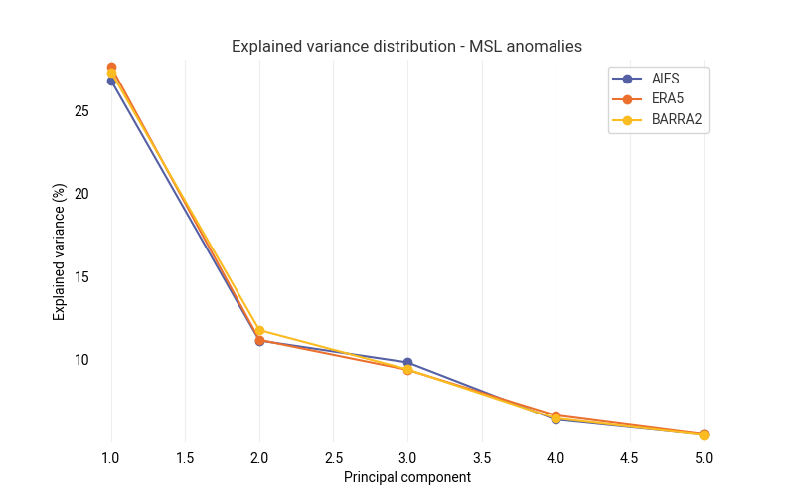
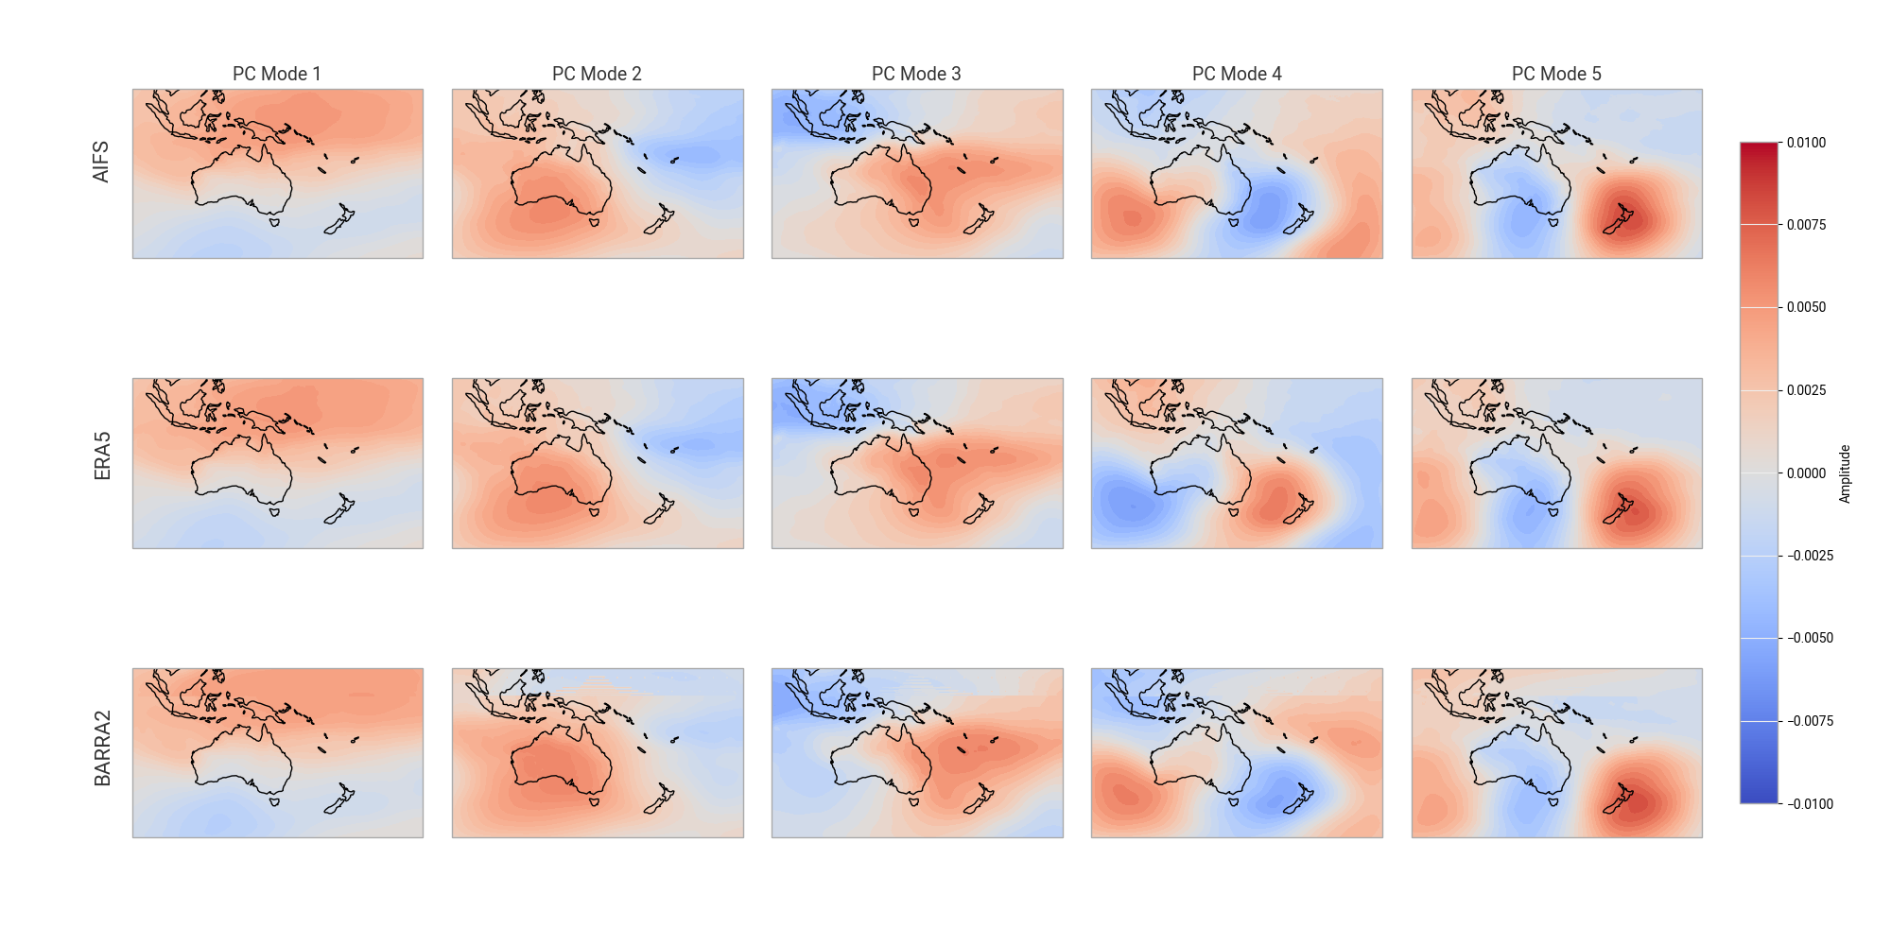
I – PCA
Main modes of variability – 2024 MSL anomalies

Slide 3
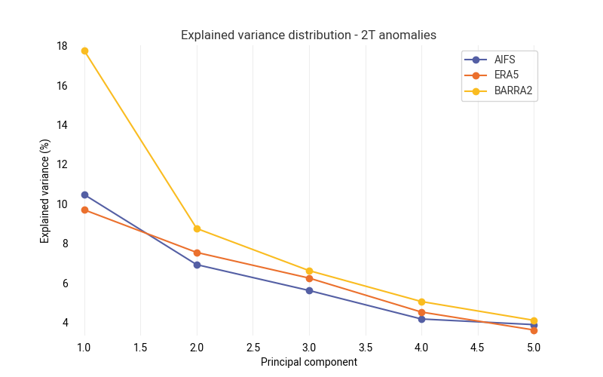
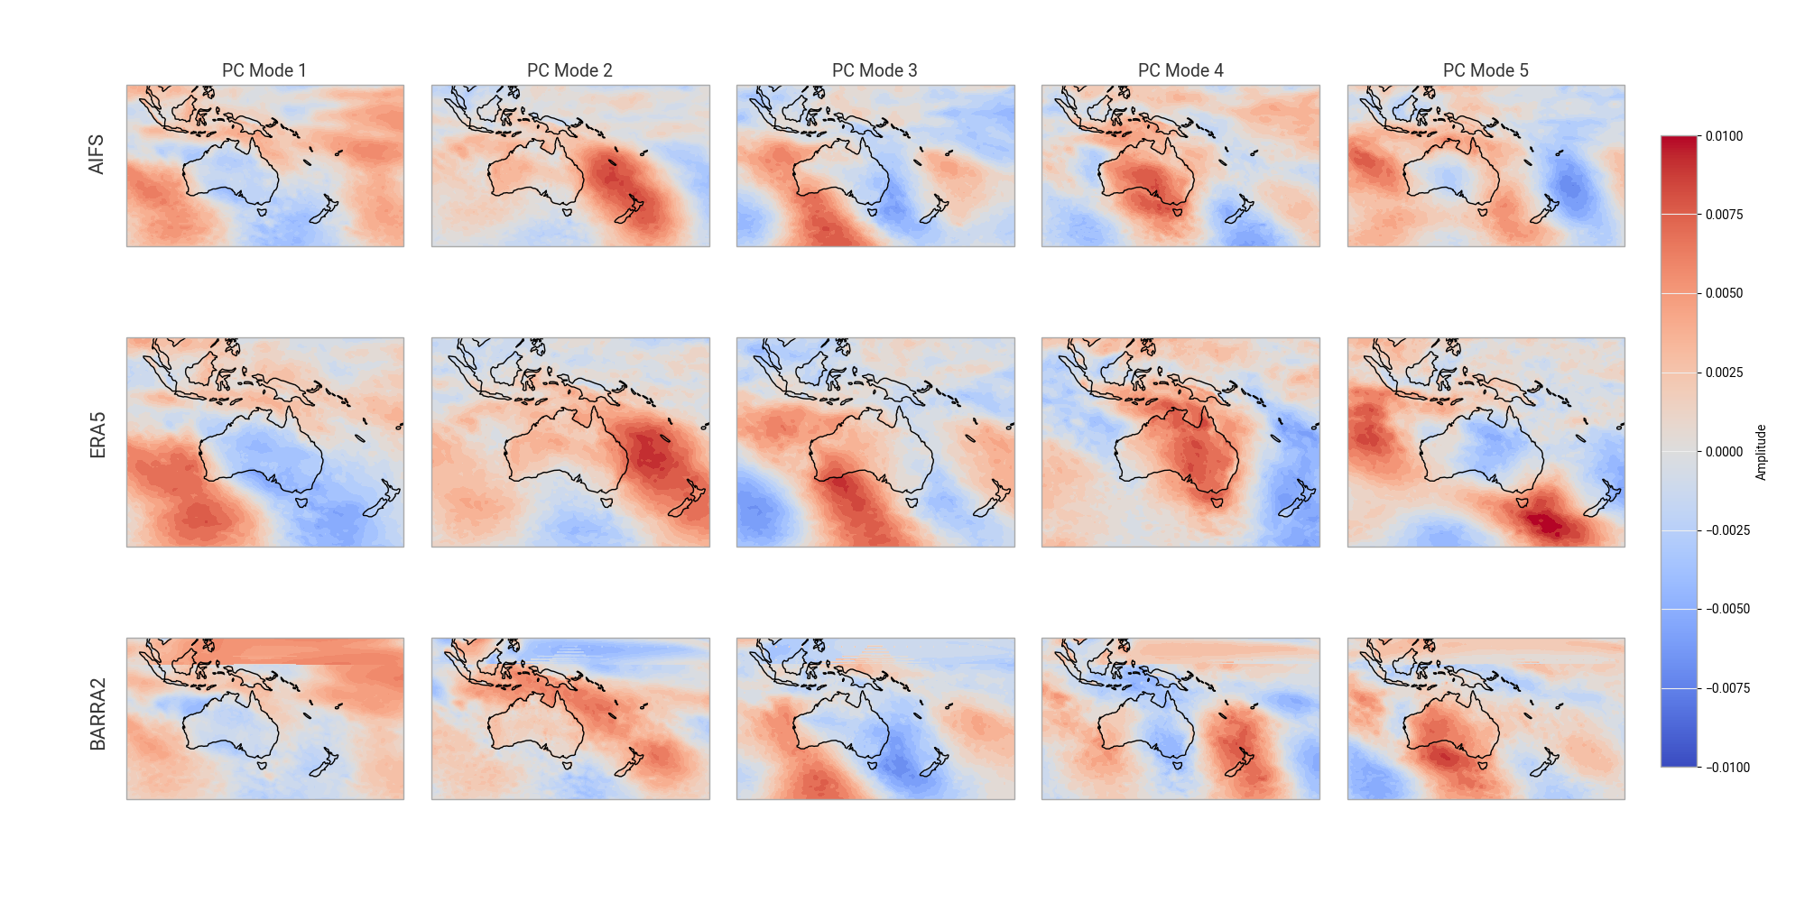
I – PCA
Main modes of variability – 2024 2T anomalies

Slide 4
I – PCA
AIFS close to ERA5 (large spatial and temporal scales)
AIFS closer to ERA5 than BARRA2
Notes :
The first twelve timesteps of AIFS where used to fully cover 2024
Only the spatial extent and intensity of the fields can be compared, not the sign of the fields

Slide 5
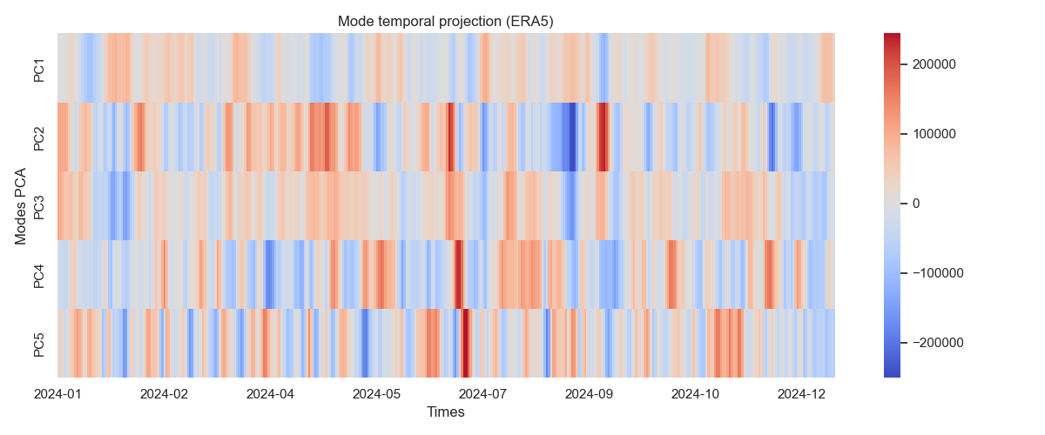
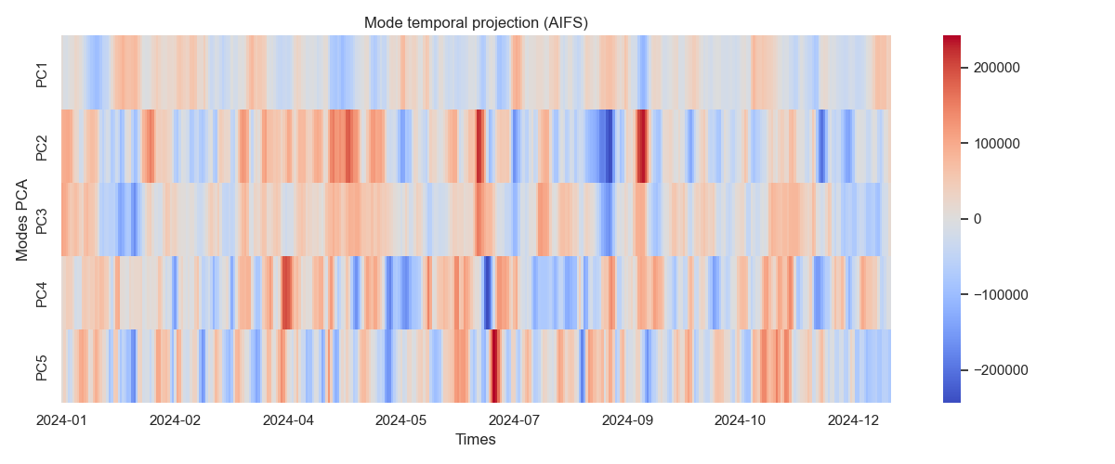
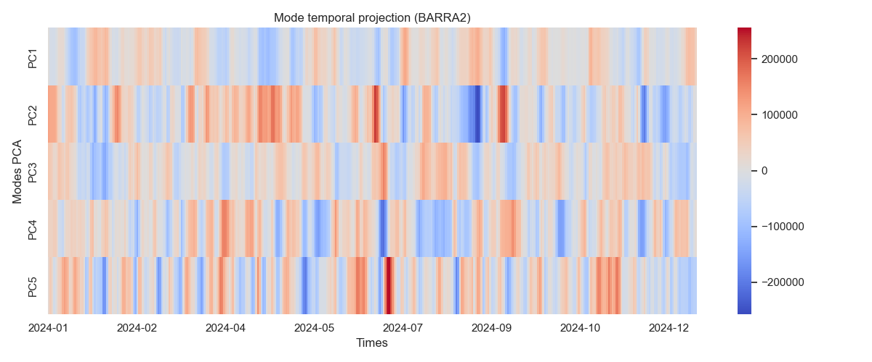
I – PCA
PC1

Slide 6
I – PCA
PC2

Slide 7
I – PCA
PC3

Slide 8
II – Energy spectrum
1 - Zonal Fourier transform
2 - Fourier spectra for regional models
3 - Spherical Harmonics

Slide 9
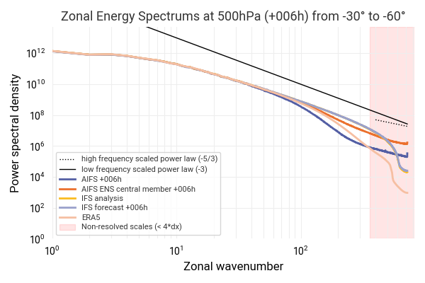
II – Energy spectrum
1 - Zonal Fourier transform
Method :
- Select a range of latitudes
Perform Fourier transform
Average on times
Average on latitudes (lat-weighting)

Slide 10

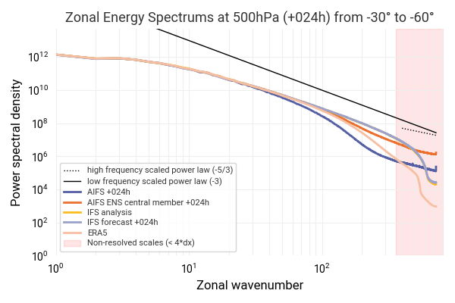
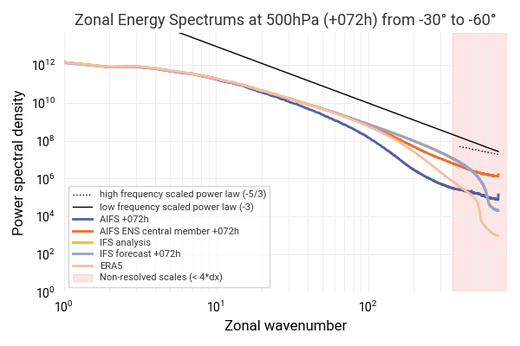

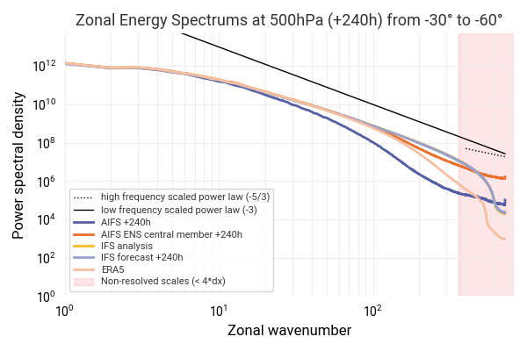
II – Energy spectrum
1 - Zonal Fourier transform
Evolution with lead time

Slide 11
II – Energy spectrum
1 - Zonal Fourier transform

Slide 12
II – Energy spectrum
1 - Zonal Fourier transform

Slide 13
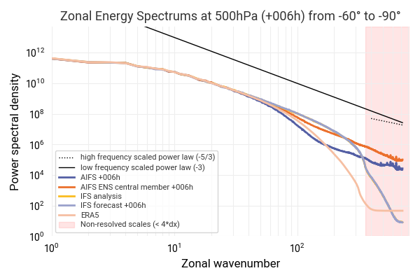
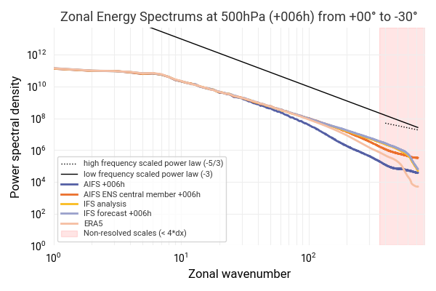
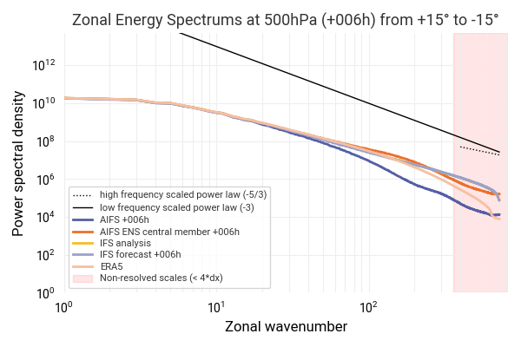
II – Energy spectrum
+6H lead time – 500 hPa – Spectrum of wind speed at different latitudes
1 - Zonal Fourier transform

Slide 14
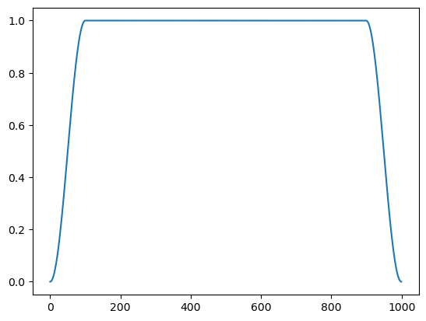
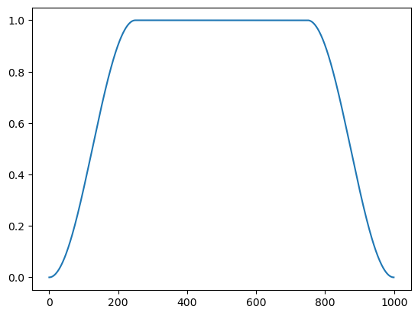
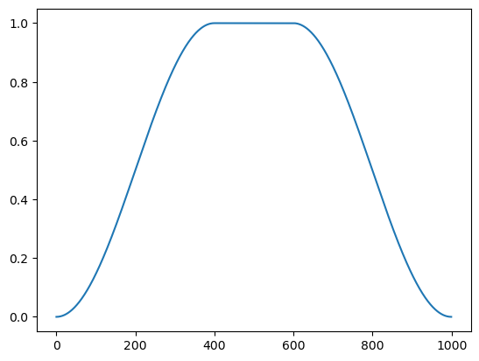
II – Energy spectrum
2 - Fourier spectra for regional models
Method :
Reduce all fields to BARRA2 AUS-22 domain
Use 1D tukey tapering along longitudes
Perform FFT as usual

Slide 15
II – Energy spectrum
2 - Fourier spectra for regional models

Slide 16
II – Energy spectrum
Todo :
BARRA2 and limited area models : Add 0 padding to improve physical accuracy
Then :
Spherical harmonics or BRIS

